Slide 1
ATAI
Advanced Techniqueof Artificial Intelligence
ATAI
ChongqingUniversity _{AdvancedTechniqueof}
of Technology Artificial Intelligence
Chongqing University of
Technology
Chongqing University ^{ATAI}
_{of Technology} Advanced Techniqueof
Artificial Intelligence
Chongqing University of Technology
Chongqing University of Technology
SelfGNN: Self-Supervised Graph Neural Networks for
Sequential Recommendation
code:https://github.com/HKUDS/SelfGNN
—— SIGIR 2024
Reported by ZhenDong Huang
1

Slide 2
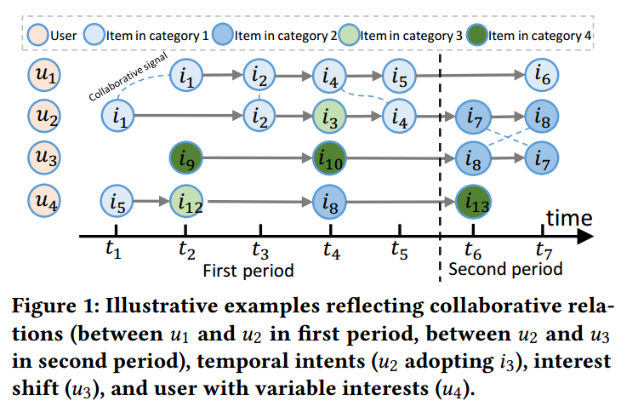
ATAI
AdvancedTechniqueof
Artificial Intelligence
ATAI
ChongqingUniversity _{AdvancedTechniqueof}
of Technology Artificial Intelligence
ChongqingUniversity of Technology
Motivation
1) existing long-short-termsequential recommenders often mainly focus on encoding single user sequence, which overlook the essential periodical collaborative relationships between users
2)the notion of "noise"varies for different users, as some users have diverse interests while others have more stable preferences. Current denoising approaches lack the ability to effectively handle user-specific noise and oftenrely on random data augmentation

Slide 3
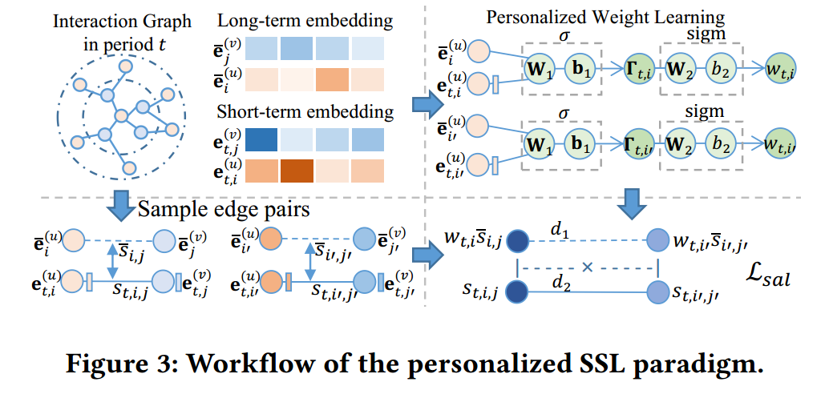
ChongqingUniversity of Technology
ATAI
AdvancedTechniqueof
Artificial Intelligence
ATAI
ChongqingUniversity _{AdvancedTechniqueof}
of Technology Artificial Intelligence
Overview

Slide 4
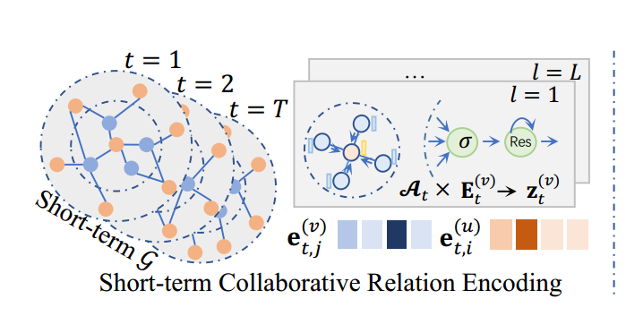
ChongqingUniversity of Technology
ATAI
AdvancedTechniqueof
Artificial Intelligence
ATAI
ChongqingUniversity _{AdvancedTechniqueof}
of Technology Artificial Intelligence
Method

Slide 5
ChongqingUniversity of Technology
ATAI
AdvancedTechniqueof
Artificial Intelligence
ATAI
ChongqingUniversity _{AdvancedTechniqueof}
of Technology Artificial Intelligence
Method

Slide 6
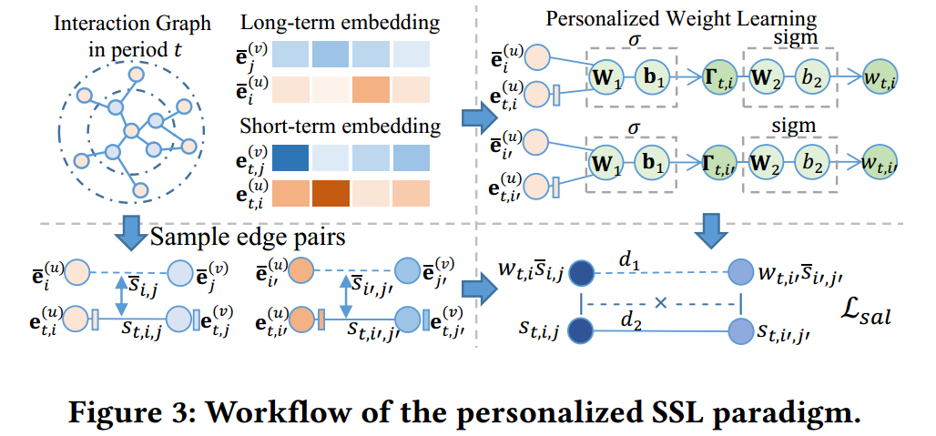
ChongqingUniversity of Technology
ATAI
AdvancedTechniqueof
Artificial Intelligence
ATAI
ChongqingUniversity _{AdvancedTechniqueof}
of Technology Artificial Intelligence
Method

Slide 7
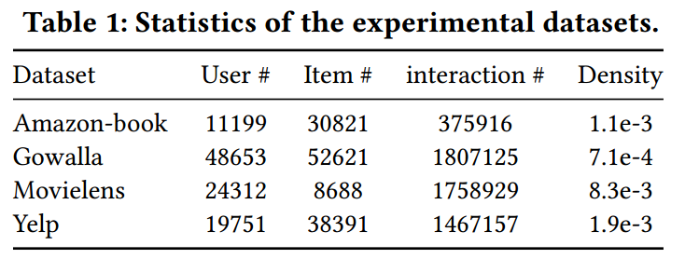
ATAI
AdvancedTechniqueof
Artificial Intelligence
ATAI
ChongqingUniversity _{AdvancedTechniqueof}
of Technology Artificial Intelligence
ChongqingUniversity of Technology
Experiments

Slide 8
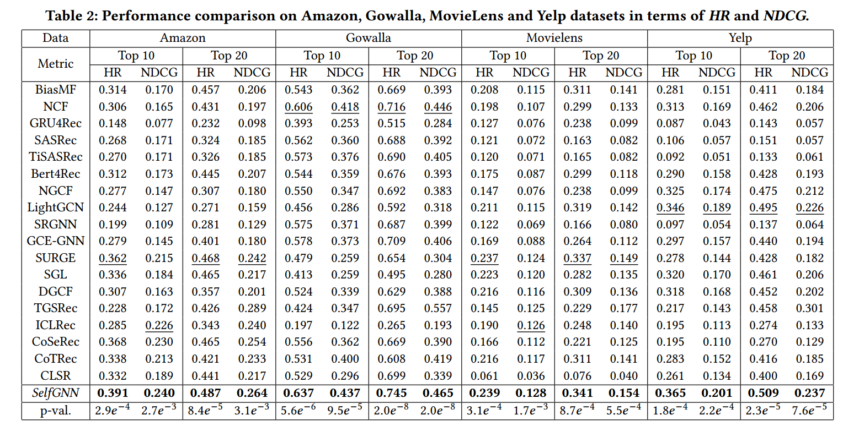
ATAI
AdvancedTechniqueof
Artificial Intelligence
ATAI
ChongqingUniversity _{AdvancedTechniqueof}
of Technology Artificial Intelligence
ChongqingUniversity of Technology
Experiments

Slide 9
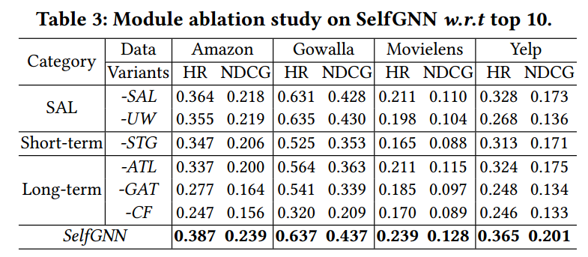
ATAI
AdvancedTechniqueof
Artificial Intelligence
ATAI
ChongqingUniversity _{AdvancedTechniqueof}
of Technology Artificial Intelligence
ChongqingUniversity of Technology
Experiments

Slide 10
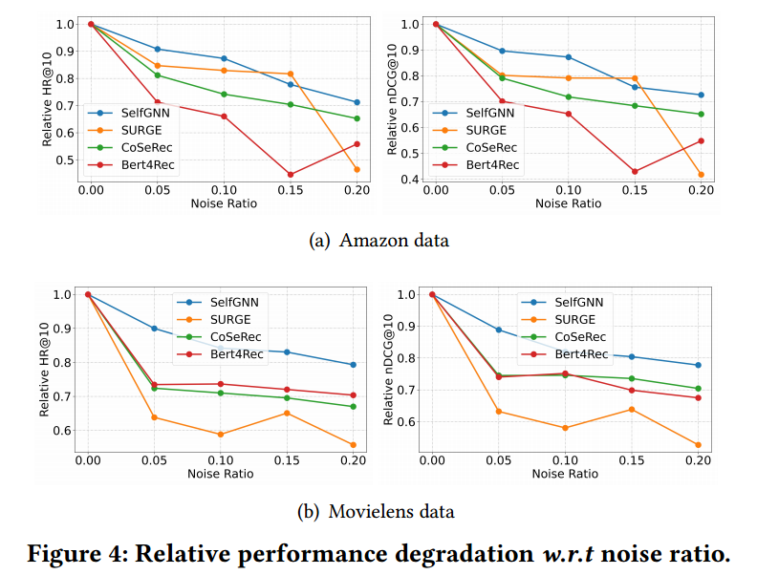
ATAI
AdvancedTechniqueof
Artificial Intelligence
ATAI
ChongqingUniversity _{AdvancedTechniqueof}
of Technology Artificial Intelligence
ChongqingUniversity of Technology
Experiments

Slide 11
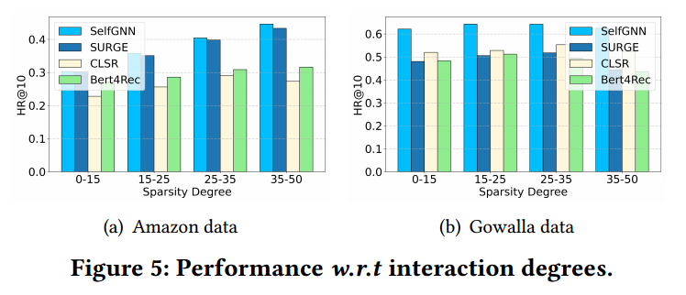
ATAI
AdvancedTechniqueof
Artificial Intelligence
ATAI
ChongqingUniversity _{AdvancedTechniqueof}
of Technology Artificial Intelligence
ChongqingUniversity of Technology
Experiments

Slide 12
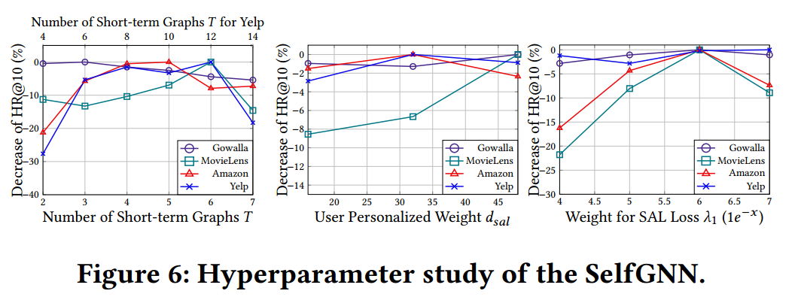
ATAI
AdvancedTechniqueof
Artificial Intelligence
ATAI
ChongqingUniversity _{AdvancedTechniqueof}
of Technology Artificial Intelligence
ChongqingUniversity of Technology
Experiments

Slide 13
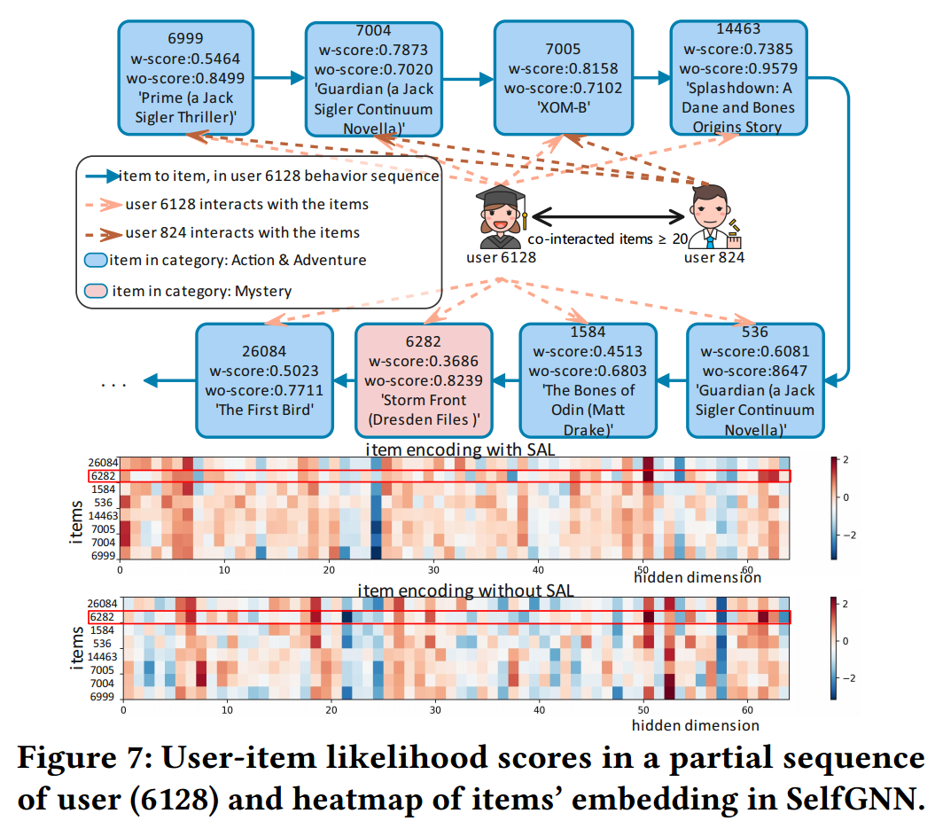
ATAI
AdvancedTechniqueof
Artificial Intelligence
ATAI
ChongqingUniversity _{AdvancedTechniqueof}
of Technology Artificial Intelligence
ChongqingUniversity of Technology
Experiments

Slide 14
ATAI
AdvancedTechniqueof
Artificial Intelligence
ATAI
ChongqingUniversity _{AdvancedTechniqueof}
of Technology Artificial Intelligence
ChongqingUniversity of Technology
Experiments

Slide 15
ChongqingUniversity of Technology
ATAI
AdvancedTechniqueof
Artificial Intelligence
ATAI
ChongqingUniversity _{AdvancedTechniqueof}
of Technology Artificial Intelligence
Thanks!

